Slide 1


Emotional Intelligence

Slide 2
Key Points
01
To enable students to learn what emotional intelligence is
02
Differentiation between IQ and EQ
03
Discuss the significance of EI in one’s personal and professional life
04

Slide 3
Emotional Intelligence
“Emotional intelligence or EI is the ability to understand and manage your own emotions, and those of the people around you”
Notes:
People with a high degree of emotional intelligence know what they're feeling, what their emotions mean, and how these emotions can affect other people.

Slide 4
EQ vs. IQ
Emotional Intelligence (EQ):
Emotional intelligence is your ability to recognize and understand emotions in yourself and others,
and your ability to use this awareness to manage your behavior and relationships.
(Goleman & Boyatzis)
Cognitive Intelligence (IQ):
Your ability to learn and understand new situations, reason through a given problem, and apply
knowledge to a current situation.
IQ AND EQ
IQ (intelligence quotient) defines how smart you are,
EQ (emotional quotient) defines how well you use what smarts you have.

Slide 5

Anyone can become angry,
that is easy. But to be angry
with the right person, to the
right degree, at the right time,
for the right purpose, and in
the right way ---that is not easy. (Aristotle)

Slide 6
Knowing emotions is the first step … But Managing them is more important

Slide 7
So ….What is Emotional Intelligence

Slide 8
“a form of social intelligence that involves the ability to monitor one's own and others' feelings and emotions, to discriminate
among them, and to use this information to guide one's thinking and action”.
Peter Salovey and John D. Mayer (1990)
“ the capacity for recognizing our own
feelings and those of others, for motivating
ourselves and for managing emotions well in ourselves and in our relationships”.
Daniel Goleman (1998)

Slide 9
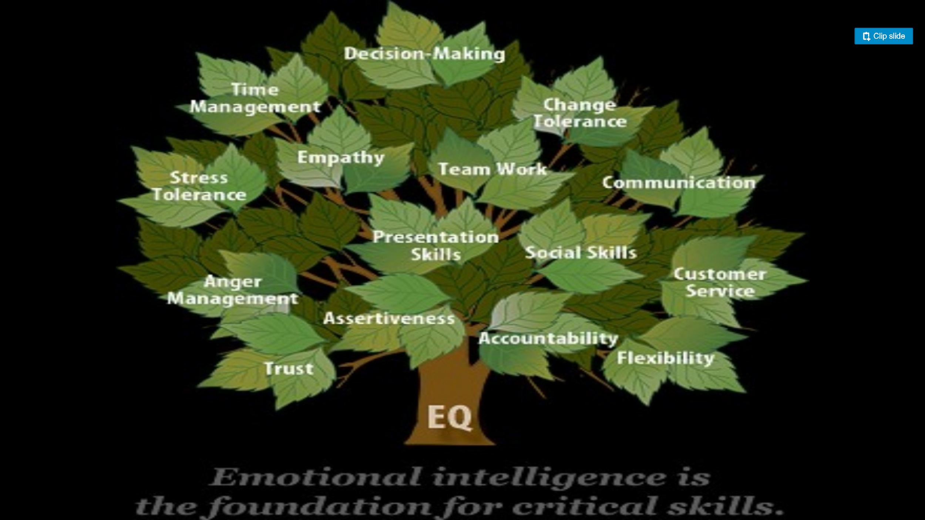

Slide 10
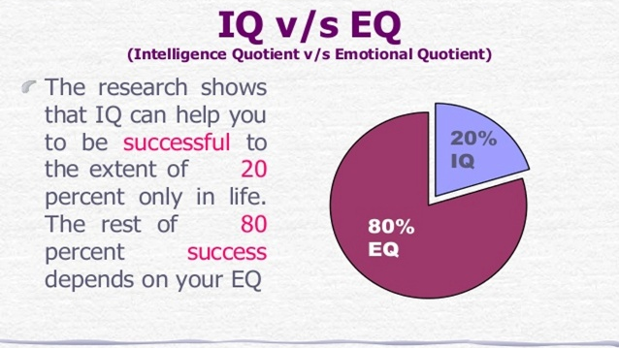

Slide 11
People who are Emotionally Literate Are,
Aware of their bodily response to events or people.
Able to discriminate between one type of response and another.
Able to choose the most effective ways of acting and are not controlled by their emotions.
Can accept and value their positive and negative feelings.
Take responsibility for their feelings.

Slide 12

“Research shows that, for better or worse, emotions influence employees’
commitment, creativity, decision making, work quality, and likelihood of
sticking around – and you can see the effects on the bottom line.”
Harvard Business Review Jan-Feb 2016

Slide 13
Thank you

